Slide 1


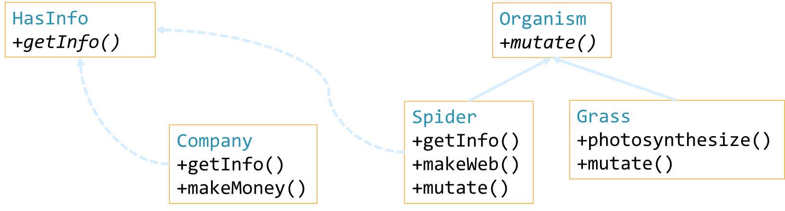
Pure-Virtual Members & Multiple Inheritance
How Inheritance Works, Pure-virtual, Multiple Inheritance
Zhivko Petrov
A guy that knows C++

Slide 2

Table of Contents
Inheritance & Polymorphism in Memory
Pure-virtual Members & Abstract classes
OOP Interfaces in C++
OOP Abstract Classes vs. OOP Interfaces
Multiple Inheritance
Runtime Type Checking – dynamic_cast

Slide 3
Questions
sli.do #cpp-softuni

Slide 4
Inheritance in Memory
Why Base Pointers Work

Slide 5
Objects in Memory
Fields in memory follow declaration order (usually)
“Padding” is auto-added to make size multiple of the biggest primitive data type used in the object.
class Organism {
float weight; bool eatsPlants; bool eatsAnimals;
public:
Organism(float w, bool p, bool a) : weight(w), eatsPlants(p), eatsAnimals(a) {}
};
Organism o(42, true, false);
Organism o
weight
eatsPlants
eatsAnimals
Address | ... | 0x6afe4c…0x6afe4f | 0x6afe50 | 0x6afe51 | 0x6afe52 | 0x6afe53 | ...
Byte_{(binary)} | ... | 42 | true | false | padding | padding | ...

Slide 6
Inheritance in Memory
Base class members inserted at start of derived object
class Spider : public Organism {
int numLegs; float weight; // NOTE: hiding weight field from Organism
public:
Spider(int l, float w) : Organism(w, false, true), numLegs(l), weight(w) {}
};
Spider s(6, 0.1);
Spider s
Organism
numLegs
weight
Address | ... | 0x6afe4c…0x6a53 |  |  |  |  | 0x6afe54…0x6afe57 | 0x6afe58…0x6afe61 | ...
Byte_{(binary)} | ... | 0.1 | false | true | ... | ... | 6 | 0.01 | ...

Slide 7
Inheritance & Hidden Fields – Memory
class Organism {
float weight; bool eatsPlants;
bool eatsAnimals; ...
};
Spider s
Organism members
class Spider : public Organism {
int numLegs; float weight;
...
};
float weight
bool eatsPlants
bool eatsAnimals
Organism o
int numLegs
float weight
float weight
bool eatsPlants
bool eatsAnimals

Slide 8
Inheritance & Hidden Fields – Pointers
Spider s
Spider s(6, 0.042);
Organism *oPtr = &s;
oPtr->weight;
oPtr->eatsPlants;
oPtr->numLegs; //compilation error
Spider * sPtr = (Spider*)oPtr;
sPtr->weight;
Organism members
float weight
bool eatsPlants
bool eatsAnimals
Organism o
int numLegs
float weight
float weight
bool eatsPlants
bool eatsAnimals

Slide 9
Inheritance in Memory
LIVE DEMO

Slide 10
Hidden Methods in Memory – NO virtual
class Organism { ...
string getInfo() const {
...
}
};
Spider s
class Spider : public Organism { ...
string getInfo() const {
...
}
};
Organism members
string getInfo()
{ /*organism implementation*/ }
Spider s;
Organism *oPtr = &s;
oPtr->getInfo();
Spider *sPtr = &s;
sPtr->getInfo();
string getInfo()
{ /*spider implementation*/ }

Slide 11
virtual Methods in Memory
class Organism { ...
virtual string getInfo() const {
...
}
};
Spider s
Organism members
vtable * vtPtr
(hidden)
class Spider : public Organism {
virtual string getInfo() const {
...
}
};
Organism vtable (hidden)
Method
virtual string getInfo()
...
Code
{/*organism implementation*/}
{...}
Spider s;
Organism *oPtr = &s;
oPtr->getInfo();
Spider *sPtr = &s;
sPtr->getInfo();
Spider vtable (hidden)
Name
virtual string getInfo()
...
Code
{/*spider implementation*/}
{...}

Slide 12
Polymorphism in Memory
LIVE DEMO

Slide 13
Pure-virtual Methods
Base Declares Methods, Derived Implements Them

Slide 14
Pure-virtual Methods
virtual methods are just pointers
To function code in memory
Pointers can point to 0/NULL/nullptr
Pure-virtual method – points to no code
i.e. function pointer to NULL
Syntax: append = 0; to virtual method signature
E.g.: virtual void write(string s) = 0;

Slide 15
C++ Abstract Classes
Abstract class – class containing pure-virtual methods
Can’t be instantiated
i.e. can’t create objects
class FileWriter : public Writer {
ofstream fileOut; string filename;
public: FileWriter(string file)
: fileOut(file), filename(file) {}
void write(string s) override {
this->fileOut << s;
this->log << "wrote " << s.size()
<< " bytes to " << filename;
}
};
class Writer {
protected: ostringstream log;
public:
Writer() {}
virtual void write(string s) = 0;
string getLog() const {
return this->log.str();
}
};
Writer writer; // compilation error
FileWriter writer("out.txt"); // ok
writer.write("hello");

Slide 16
Abstract Classes and Polymorphism
Base declares, Derived defines/implements, Code uses Base
Usable methods accessible from base pointer/reference
Pointers guaranteed to point to derived (can’t instantiate base)
Guaranteed override access – derived must have override
void writeHello(Writer* writer) {
writer->write("hello");
}
FileWriter fileWriter(“out.txt");
writeHello(&fileWriter);
void writeHello(Writer& writer) {
writer.write("hello");
}
FileWriter fileWriter(“out.txt");
writeHello(fileWriter);

Slide 17
Pure-Virtual Methods
LIVE DEMO

Slide 18
Exercise 1: Zoo
Example: Zoo of Organisms
Can act (move, stop, …), have position, image (sequence of chars)
Code provided for Cat, Mouse
Task: edit the code to initialize and animate objects of the above
Approach: Several classes have common methods
One or more methods behave differently per class
Make base abstract class with common members
Pure-virtual for the ones with unique implementations per class

Slide 19
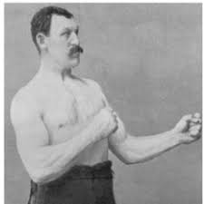
OOP Interfaces
INTERFACE?
YOU MEAN CLASS WITH ONLY
PURE-VIRTUAL METHODS
Declaring Functionality for Others to Implement

Slide 20
OOP Interfaces
Abstract classes that only declare public methods
Don’t have implementation
Derived classes required to implement methods (or be abstract)
In C++ – pure-virtual classes – all methods are pure-virtual
class Writer {
public:
virtual void write(string s) = 0;
};
// struct avoids typing public:
struct Writer {
virtual void write(string s) = 0;
};

Slide 21
OOP Interface – Common Usage
class HasInfo { public:
virtual string getInfo() const = 0;
};
Derived classes with:
Common methods
No common base
Extract interface
Contains common methods as pure-virtual methods
Derived classes inherit it in addition to their base
class Spider : public Organism
, public HasInfo {
...
string getInfo() const override {
...
class Company : public HasInfo {
...
string getInfo() const override {
...
Spider spider(...);
Company company(...);
spider.getInfo();
company.getInfo();

Slide 22
OOP Interface – Usage Diagram
Company and Spider are in different "trees"
Company is a "root", Spider is "under" the Organism "root"
Share members through HasInfo interface
OOP hierarchies are often described with diagrams
HasInfo
+getInfo()
Organism
+mutate()
Spider
+getInfo()
+makeWeb()
+mutate()
Grass
+photosynthesize()
+mutate()
Company
+getInfo()
+makeMoney()

Slide 23
OOP Interfaces Usage
LIVE DEMO

Slide 24
Multiple Inheritance
Inheriting from Multiple Base Classes

Slide 25
Multiple Inheritance
In the previous slides, we demonstrated multiple inheritance
But we used the "safe" way – interfaces
C++ allows a derived class to have multiple bases
class Derived : public Base1, public Base2, ...
Can cause member conflicts – if member names match
Internal code uses Base1::member vs. Base2::member
External code can cast to (Base1*) or (Base2&), etc.

Slide 26
Multiple Inheritance – Example
class Animal {
double movementSpeed;
};
class Plant {
bool hasSeeds;
};
class GMO : public Animal
, public Plant {
};
Animal
Plant
double weight
bool hasSeeds
GMO
Animal members
Plant Members
double weight
bool hasSeeds

Slide 27
Multiple Inheritance
LIVE DEMO

Slide 28
Multiple Inheritance – Error Prone
With C++ multiple inheritance come multiple pitfalls
Name conflicts, casting, base member calls, memory, ...
Interfaces are mostly immune to the above (except name conflicts)
The diamond problem – the root of most pitfalls
class Top;
class Left : Top; class Right : Top;
class Bottom : Left, Right;
Bottom has 2 copies of each Top member

Slide 29
The Diamond Problem
Organism
float weight
class Organism {
double weight;
};
class Animal : Organism {
double movementSpeed;
};
class Plant : Organism {
bool hasSeeds;
};
class GMO : Animal, Plant {
};
Animal : Organism
Plant : Organism
Organism
Organism
float weight
float weight
float speed
bool hasSeeds
GMO : Animal, Plant
Animal
Plant
Organism
Organism
float weight
float weight
float speed
bool hasSeeds

Slide 30
Virtual Inheritance – Solving the Diamond
Virtual Inheritance – "override" instead of copy same members
class Top;
class Left : virtual Top
class Right : virtual Top
class Bottom : Left, Right
Bottom gets single Top, that both Left and Right point to
class Animal : public virtual Organism
class GMO : public Animal
, public Plant
class Plant : public virtual Organism

Slide 31
Solving the Diamond – Diagram
class Organism { ... };
class Animal : virtual Organism { ... };
class Plant : virtual Organism { ... };
class GMO : Animal, Plant { ... };
GMO : Animal, Plant
Organism
Animal : virtual Organism
Plant : virtual Organism
float weight
Organism
Organism
float weight
float weight
Animal
Plant
vtable * organism
vtable * organism
vtable * organism
vtable * organism
float speed
bool hasSeeds
float speed
bool hasSeeds

Slide 32
Virtual Inheritance
LIVE DEMO

Slide 33
Runtime Type Checking
Using dynamic_cast for Type-Specific Handling

Slide 34
Dynamic Casting
C++ has dynamic_cast<T>(value)
Casts value to T, value must be a pointer/reference
T must be pointer/reference to a class
If cast is not possible – returns nullptr if casting to pointer
Runtime error if casting to reference
std::dynamic_pointer_cast<T>(smartPtr)
Similar to dynamic_cast<T>, but used for smart pointers

Slide 35
Runtime Type Checking
dynamic_cast allows type checking of base pointers
Cast and check if result is non-null
Spider spider(...);
Organism* upcast1 = dynamic_cast<Organism*>(&spider);
Company* toCompany = dynamic_cast<Company*>(&spider); // null
Organism* upcast2 = dynamic_cast<Organism*>(&spider);

Slide 36
dynamic_cast
LIVE DEMO

Slide 37
Avoiding Runtime Type Checking
Needing runtime type checks may indicate bad design
Prefer using overrides to define special behavior
If not possible, why?
Do we need more classes?
Do we need "wider" or better base classes?
Is the function handling more than it is responsible for?

Slide 38

Summary
C++ uses memory layout to handle inheritance
Base is at beginning of memory block
Derived continues after base in memory
Pure-virtual methods force implementation
Derived defining them guaranteed to be called due to virtual
Allows pure-virtual classes – OOP Interfaces
Multiple inheritance allows combining multiple bases
Has issues, but mostly safe with interfaces

Slide 39
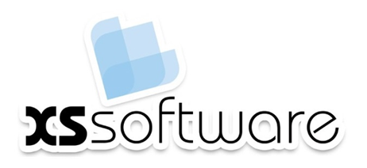






Pure-Virtual Members & Multiple Inheritance
https://softuni.bg/courses/

